Slide 1
AirBnB project
File created on: 1/9/2023 11:35:58 AM

Slide 2
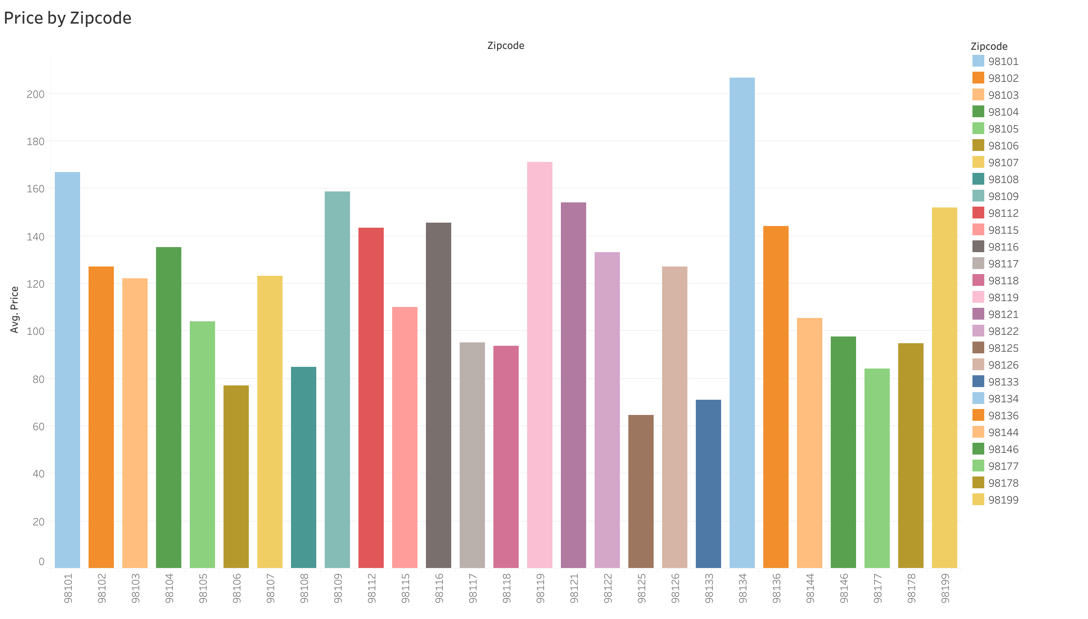

Slide 3
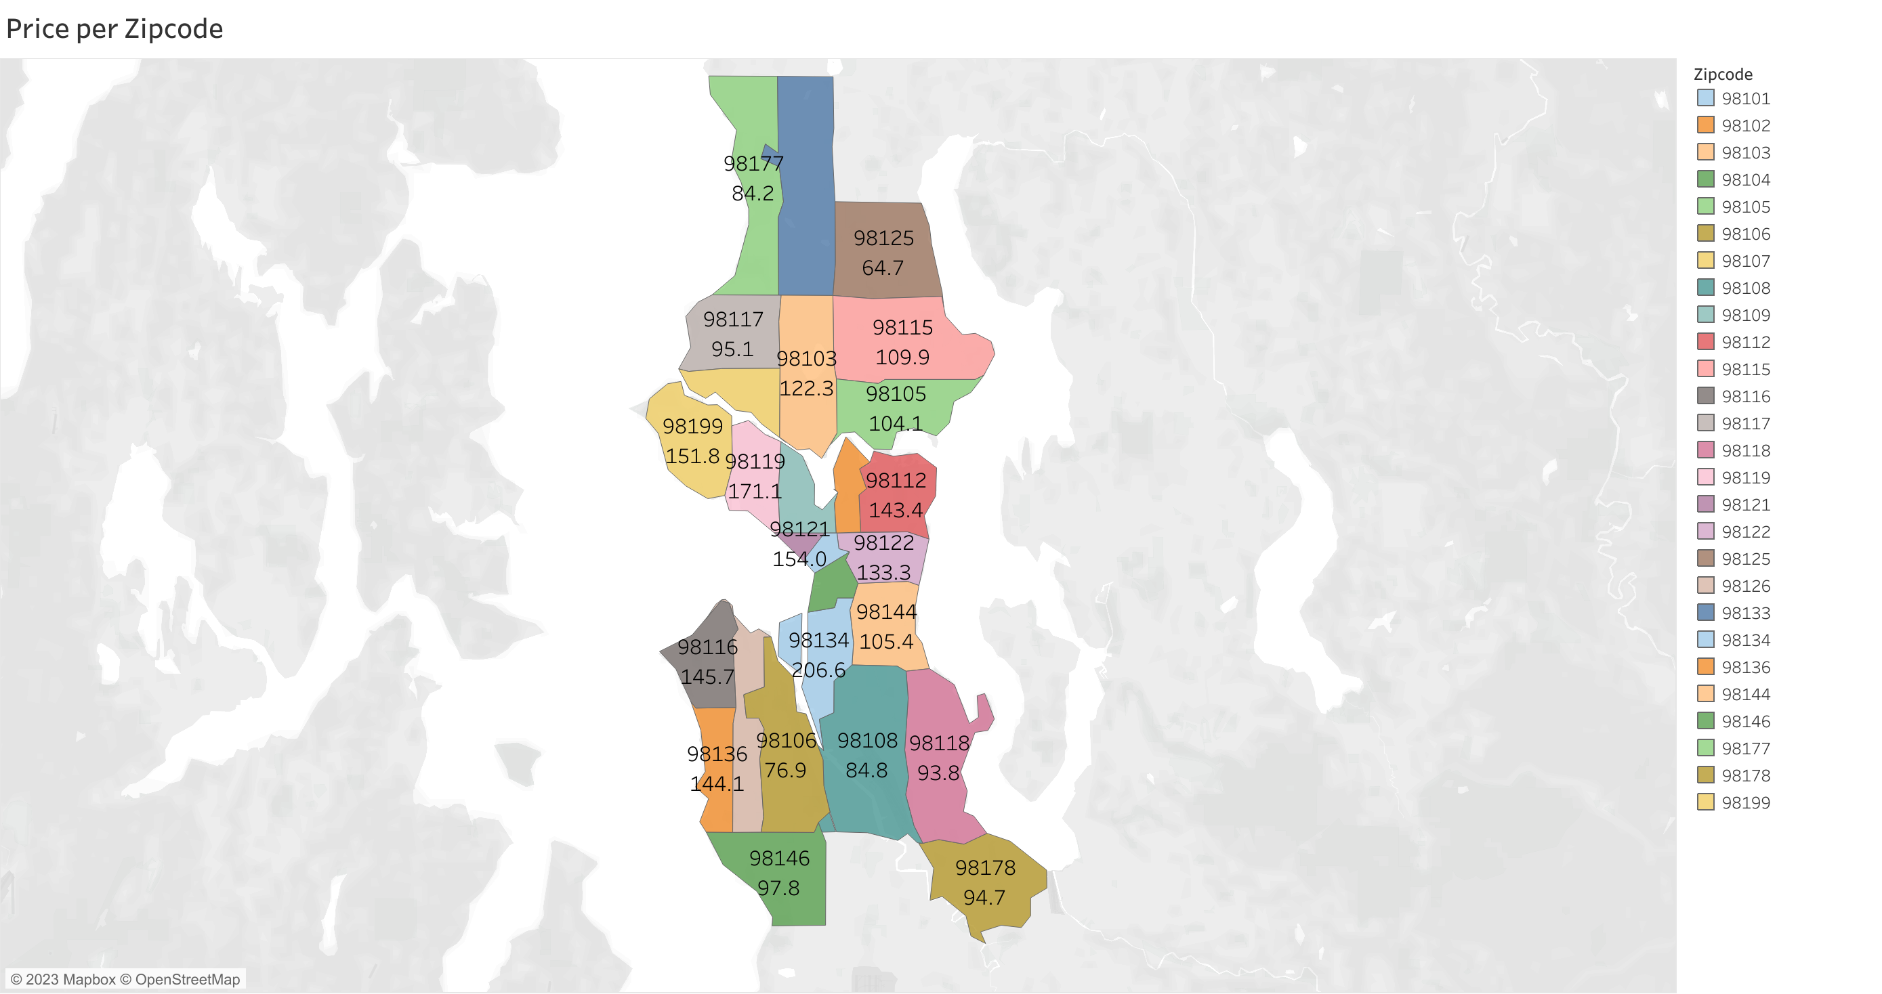

Slide 4
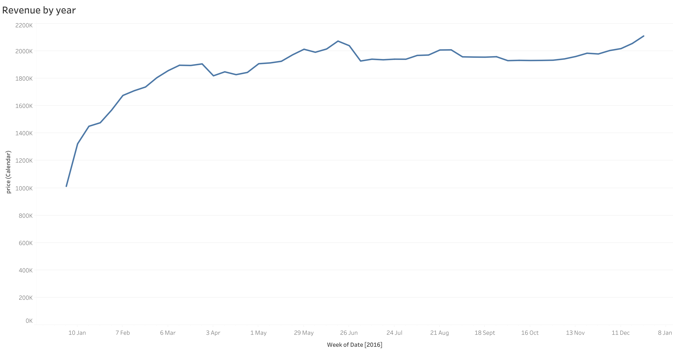

Slide 5
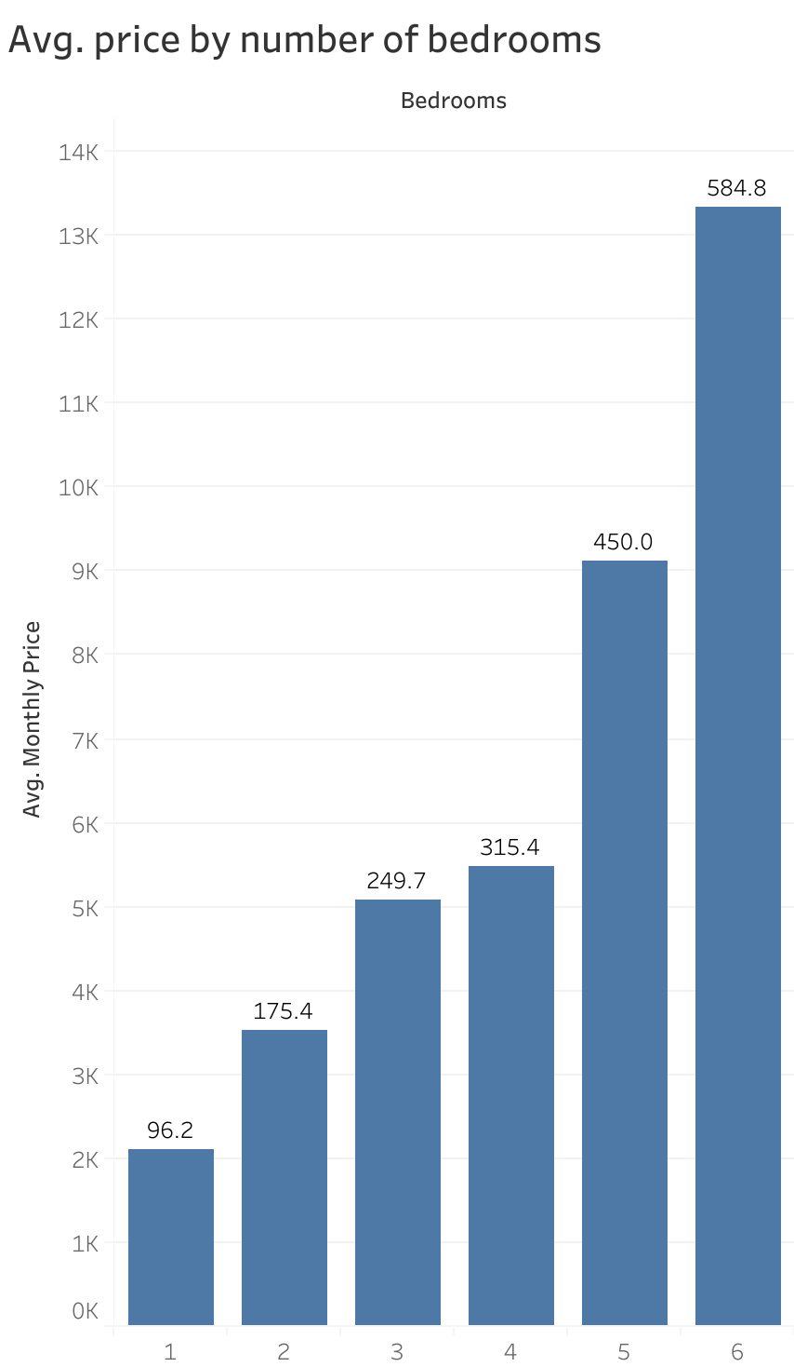

Slide 6
